Slide 1
Penny drIVE For Scholarships For Girls in Afghanistan 2013

Slide 2
Sponsored By: Springville Students For Human Rights

Slide 3
Malala Yousafzai

Slide 4
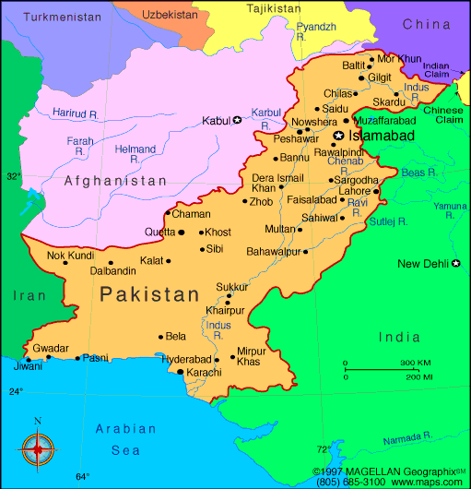
See video about Malala

Slide 5
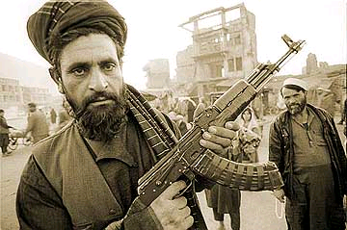
The Taliban

Slide 6
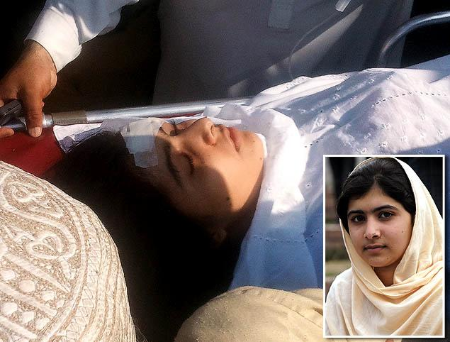

Slide 8
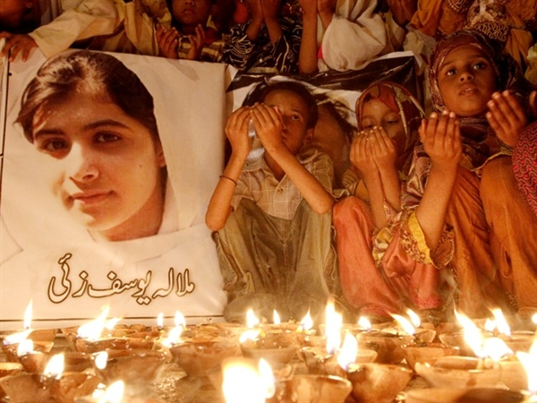
See Video on Recovery

Slide 9
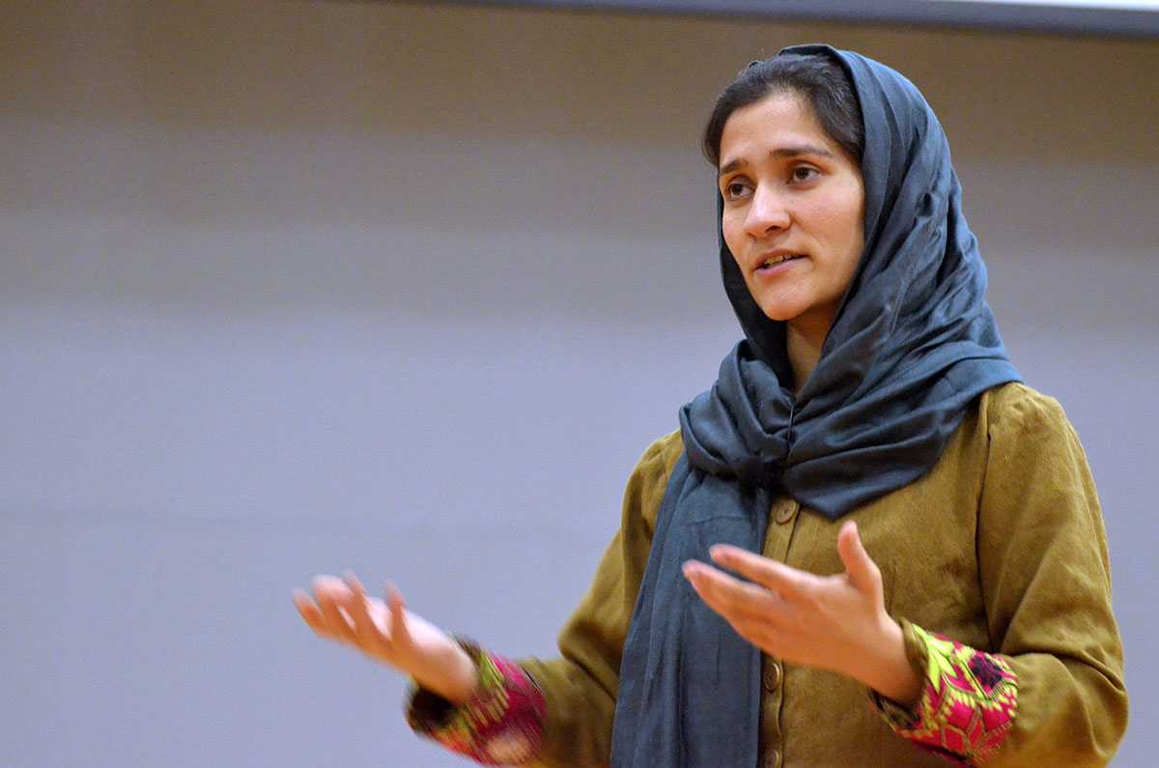
See a video of
Shabana Basij-Rasikh

Slide 11
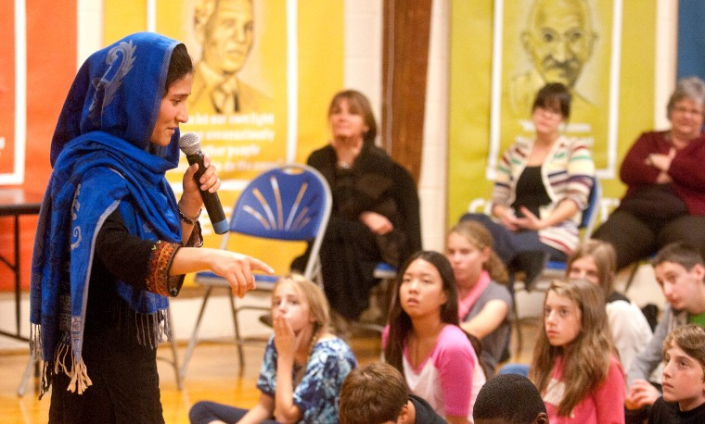

Slide 13
What We Can Do?

Slide 14
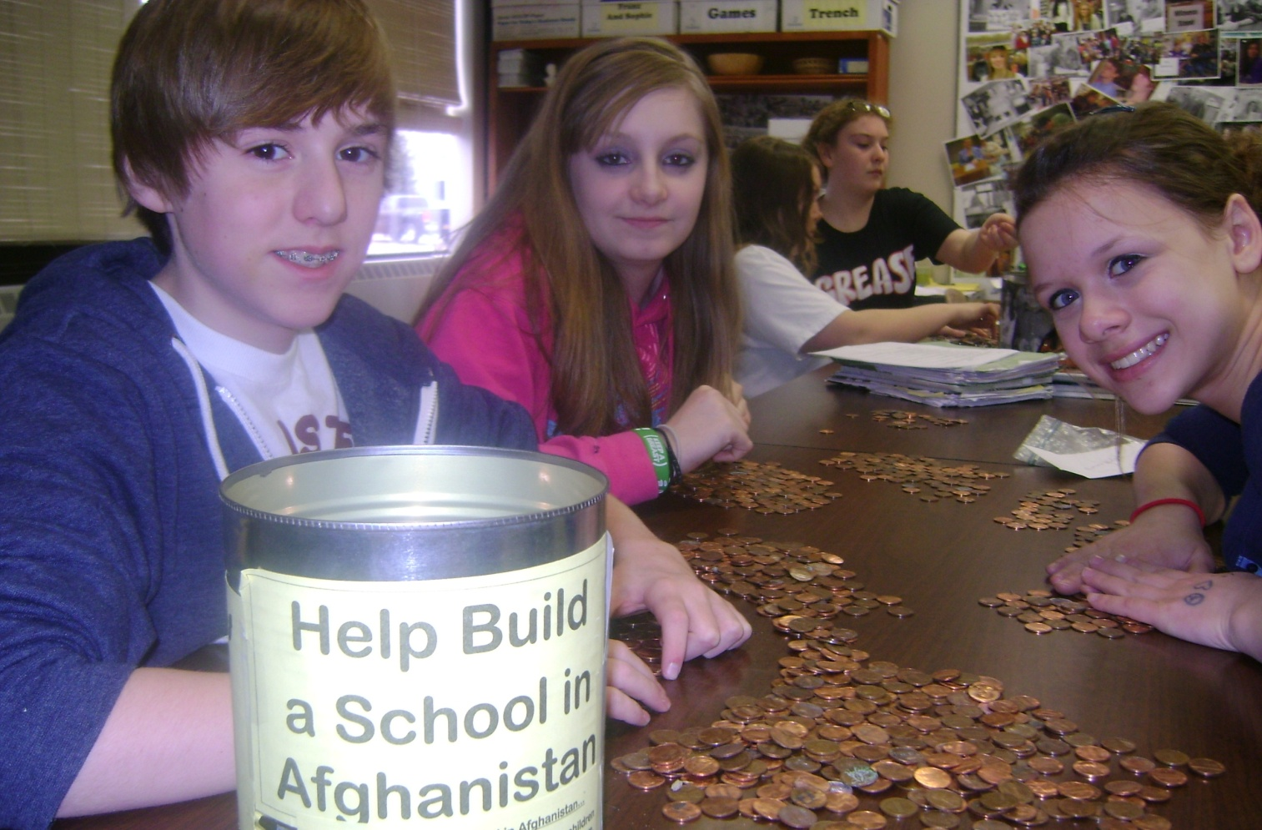
Raise money for penny drive to get scholarships

Slide 15
What the scholarships provide in one month?

Slide 16
Tuition for Afghan girls to attend SOLA

Slide 17
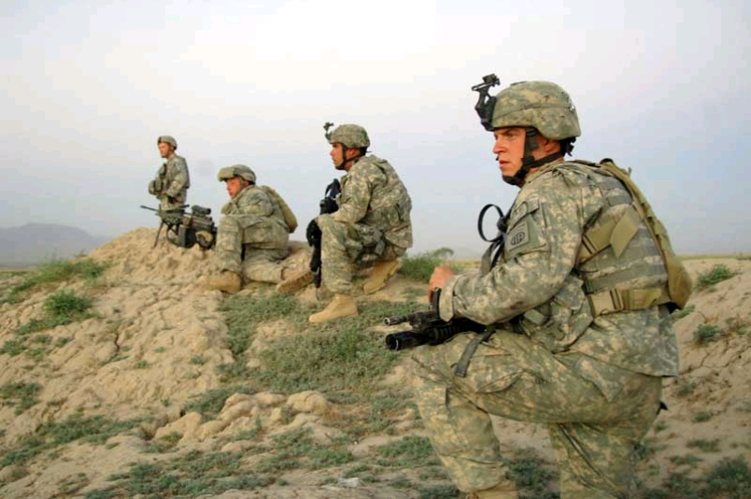
Helping them hurts the Taliban and makes things easier for our troops

Slide 18
Free donuts for the homeroom who raises the most money in each school.

Slide 19
Also,
I Am Malala Tee Shirt Sale

Slide 20
We Can Make A Difference All Around The World

Slide 21
Distribute handouts to each class.

Slide 22
Bring in your pennies tomorrow and order a tee shirt if you’d like!
Thank you for your time!

